Slide 1
Baseball vs Cricket
By Sergio Barajas

Slide 2
What is baseball about?
The game baseball is about hitting the little balls colored white and red when thrown by the pitcher with a bat.
Teams alternate positions as batters and fielders when three members of the batting team are “put out” after 3 strikes missed by the batter that was thrown by the pitcher.

Slide 3
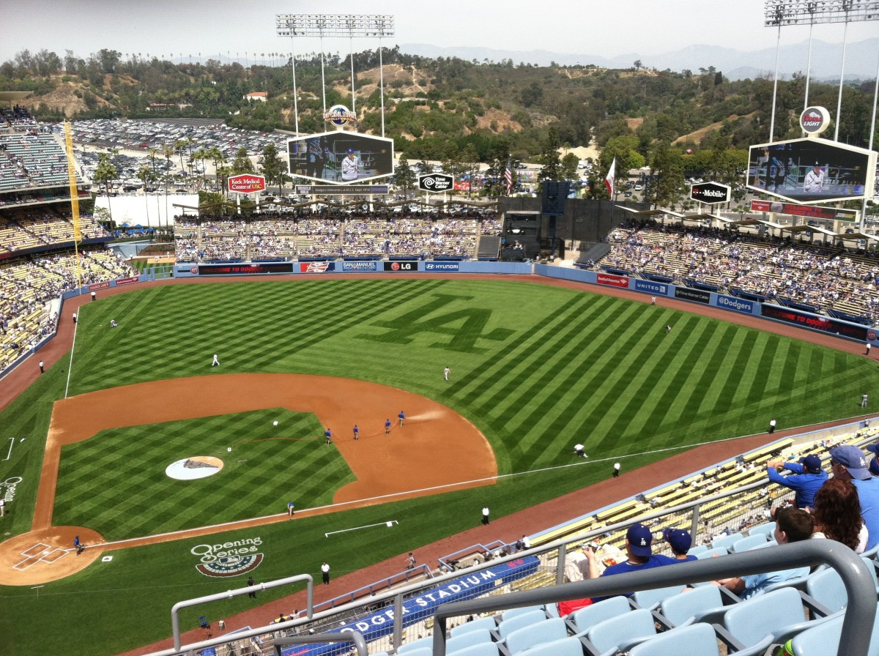
Where may you find and play baseball?
Baseball park shaped with a square.
Each square has white bases
And grass with a yellow or white fences maybe even black.
If you are lucky enough you may be able to find a good baseball park at a stadium for example the diamondbacks stadium which is the Chase Field over @ phoenix.
Or if you are a visitor/newcomer from California then you may know the baseball stadium dodgers looks somewhat like this huh.
This Photo by Unknown Author is licensed under CC BY-SA

Slide 4
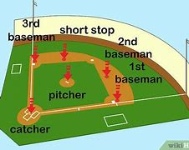
How do you when a baseball game?
To win a baseball game you and your teammates need to score more runs than your opponents.
This happens once the player manages to get around four bases before being tagged out
If you are tagged another batter from your team steps in.

Slide 5
What is your favorite baseball team?

Slide 6
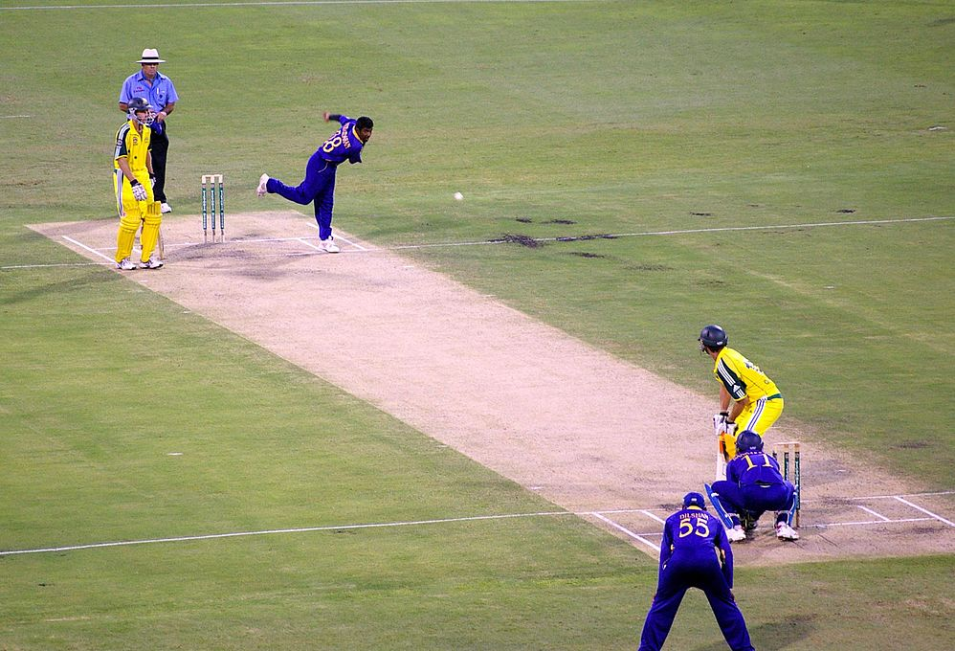
The sport cricket.
Cricket is a dynamic bat and ball game played between two teams, each consisting of eleven players, on a designated field.
This game, originally developed in England, has gained immense popularity in countries like Australia, India, Pakistan, South Africa, and the West Indies, captivating fans and players alike across the globe.
This Photo by Unknown Author is licensed under CC BY-SA

Slide 7
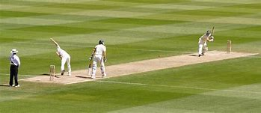
Where you may be able to play cricket, you may ask?

Slide 8
How do you win a cricket-based game.
To win a cricket game you will need to score runs by hitting the ball with your cricket and running from one end to the other.
You will need to break the wicket (goal) just for extra points
This will lead to the batter being out if he only the batter doesn’t stop the bowler,
If the batter misses then the bowler breaks the wicked and the batter will lose
If the wicket or another fielder breaks the wicket while the batter is running will result in the batter losing.
The winner is determined based on total runs scored.

Slide 9
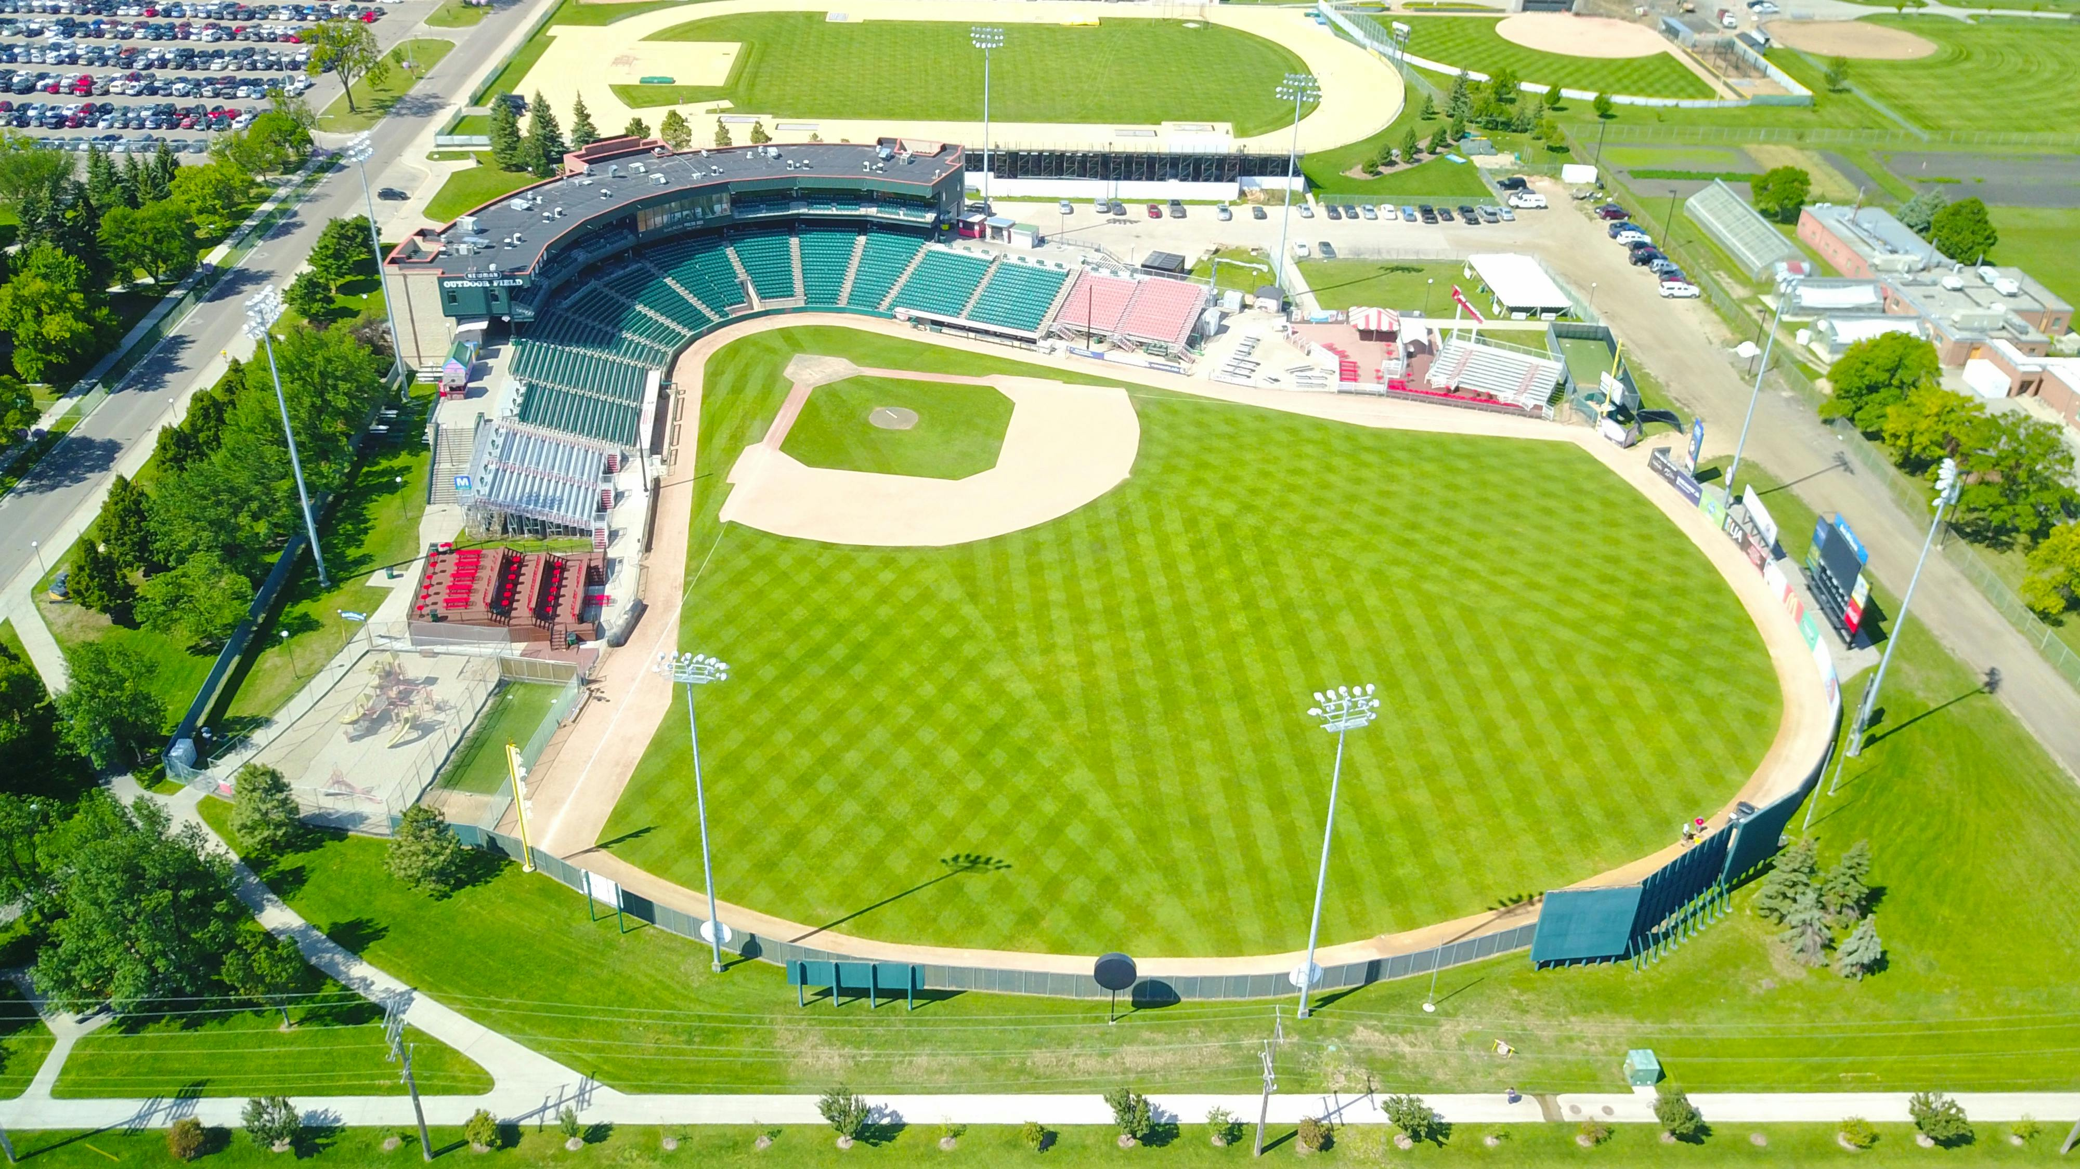
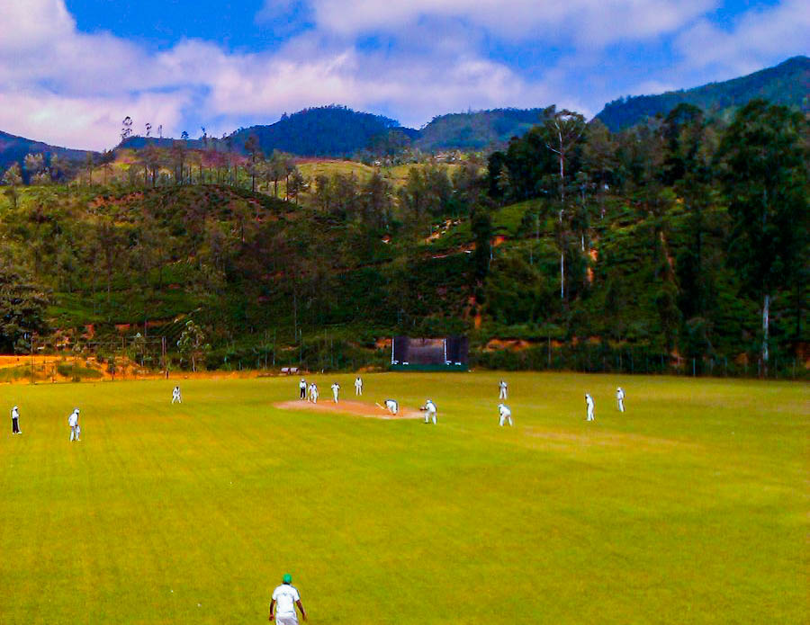
Some may say that cricket and baseball are similar though. When they also have their differences. For example.
Similarities
Both are bat-and-ball games.
Both have batters and bowlers.
Players try to catch the ball.
These games require athleticism, hand-eye coordination, and good reflexes.
Additionally, you need effective strategic tactics to succeed.
Differences
Cricket has eleven players while baseball has nine
Cricket players hold the bat down, baseball players hold the bat up
The playing fiels are different sizes and shapes
Balls are similar construction however weigh may be different
Different tactics, setup, equipment player positioning and scoring
The bat in cricket is flat while the bat in baseball is round
Different rules with regard to innings and different scoring systems

Slide 10
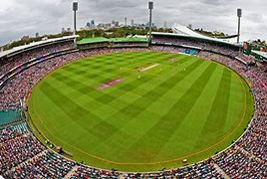
What do you guys prefer baseball or cricket?

Slide 11
I have a deep appreciation for both baseball and cricket, yet I find myself drawn more to baseball, particularly because of its rich roots in North American culture. There’s something incredibly thrilling about watching a baseball game unfold, whether it's on the vibrant screen of the television or right in the heart of a lively stadium, surrounded by passionate fans. While cricket is undoubtedly an exciting and fascinating sport with its own unique charm, I simply find that baseball captures my enthusiasm and admiration more profoundly.

Slide 12
Any questions?

Slide 13
Well, this will conclude my presentation.
I hope you all enjoy my project
Sincerely Sergio

Slide 14
The End
Baseball vs Cricket - Difference and Comparison | Diffen
Baseball | History, Definition, & Facts | Britannica
Baseball Rules: How To Play Baseball | Rules of Sport

